Slide 1
Superstore Data Visualization and Insight Generation
Ambarish Deb
Business Analyst Intern
Oeson OGIP

Slide 2
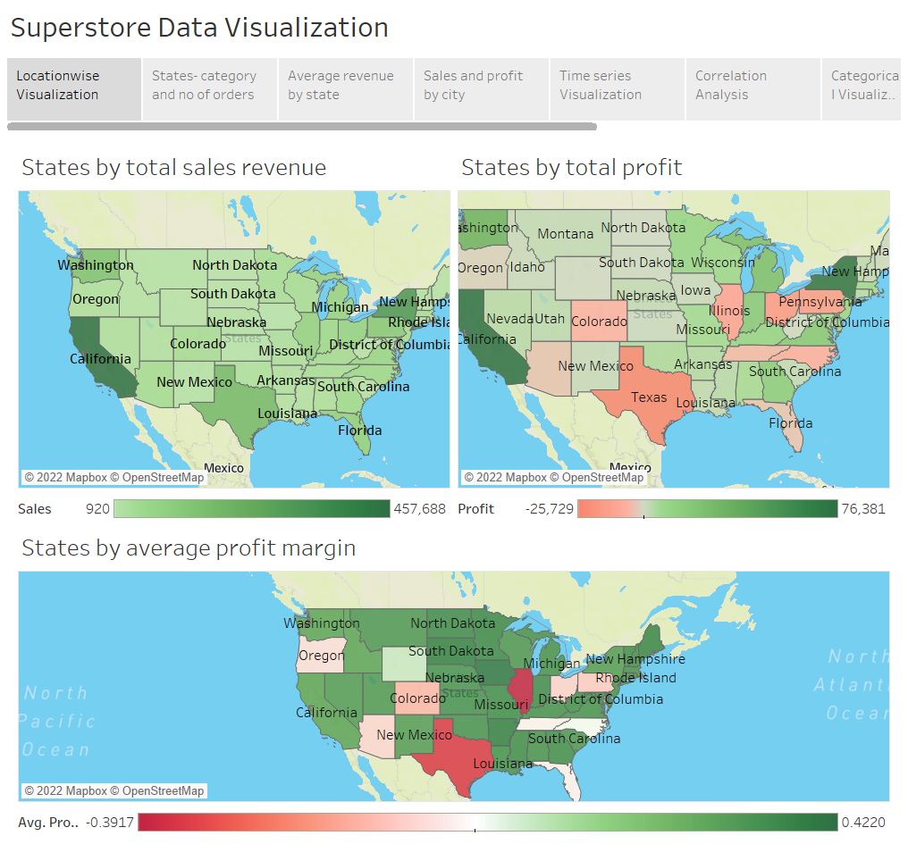

Slide 3
Insights-
California contributes the most sales revenue followed by New York.
California and New York are the most profitable states while Texas,Pennsylvania and Ohio are some of the highest loss making states.
A majority of states have a positive profit margin except Texas, Illinois, Ohio etc which have a negative profit margin.
(Note: Profit margin is a calculated field obtained by dividing profit with sales)

Slide 4
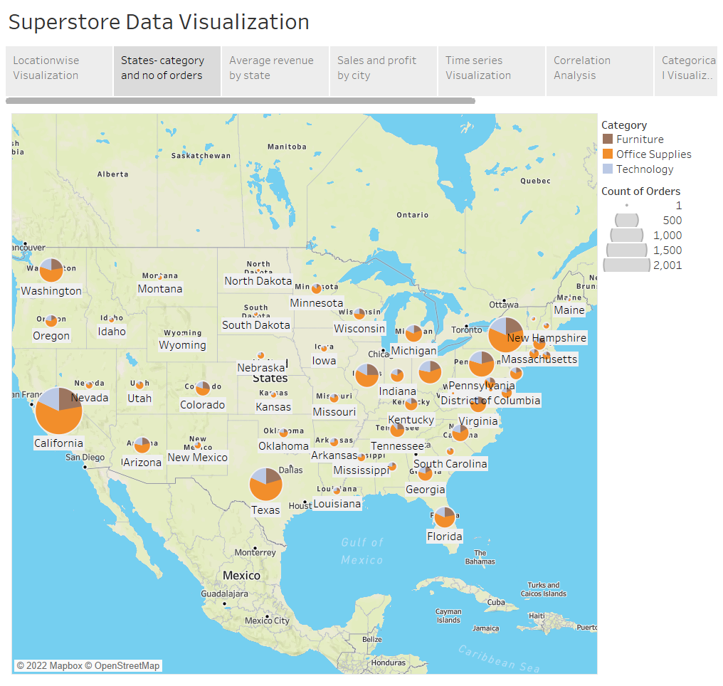

Slide 5
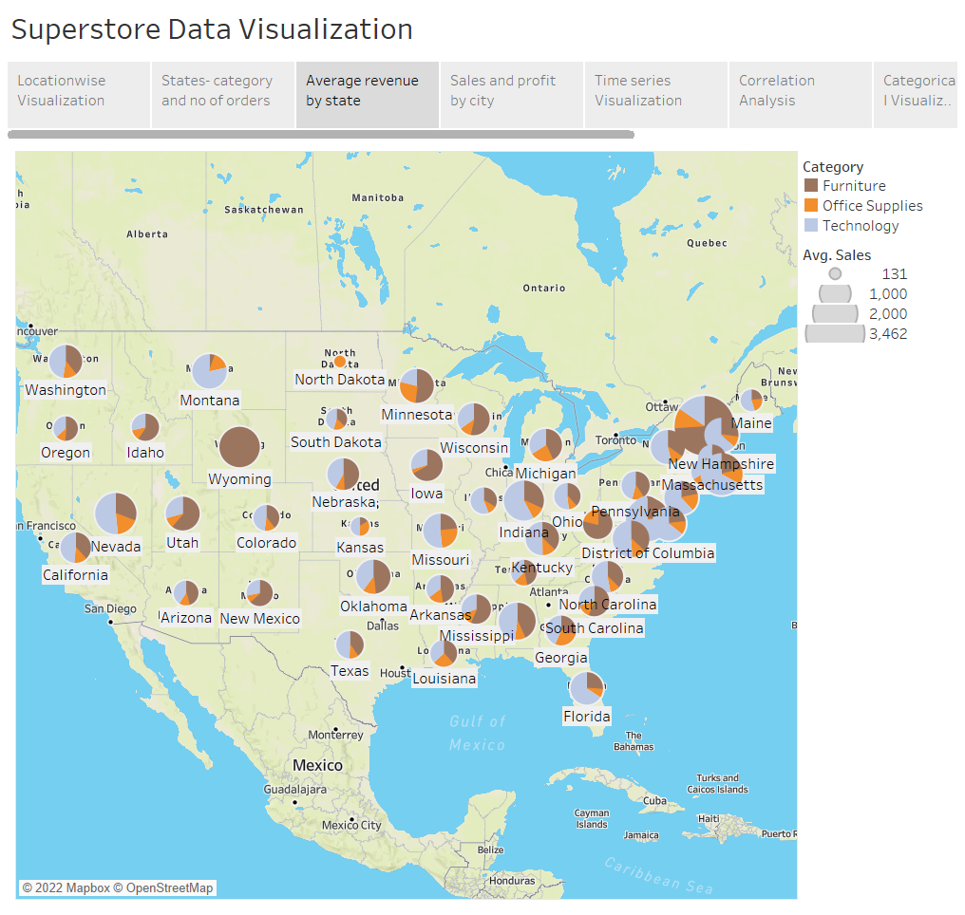

Slide 6
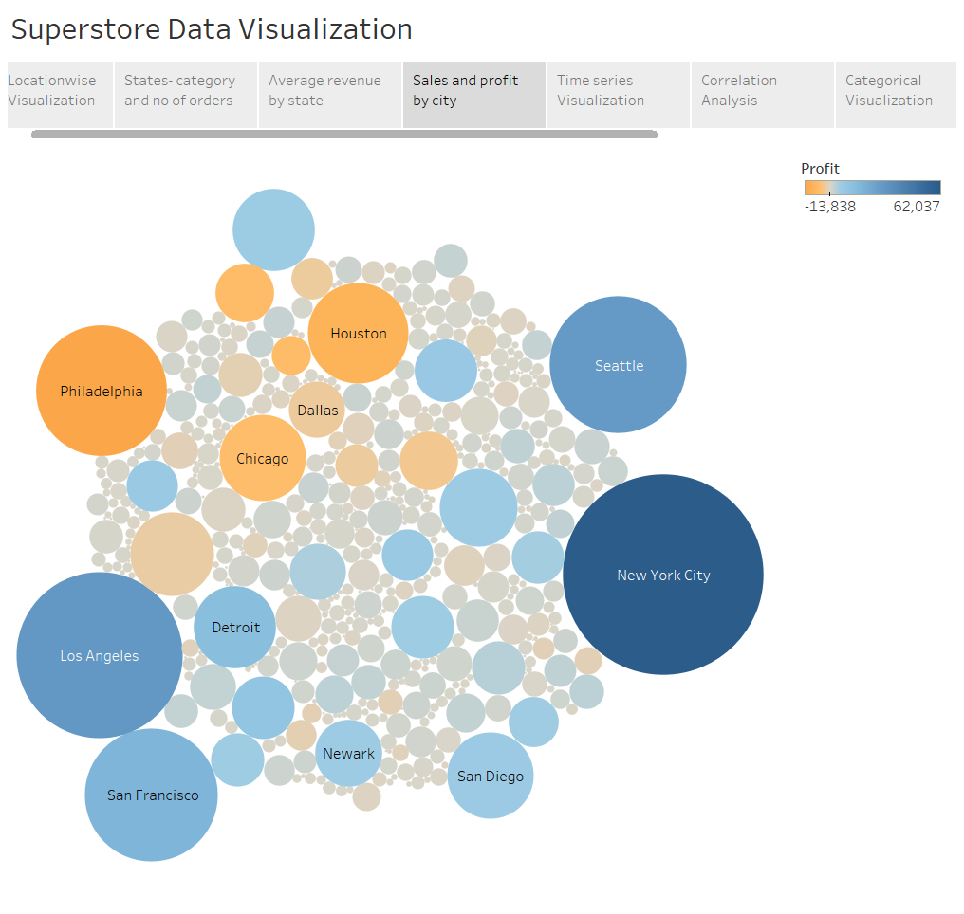

Slide 7
Insights-
Most orders come from California, New York, Texas.
In most states, Office Supplies are the most sought after category.
Although in most states, Office supply is the most sought category as established from the previous chart, most of the revenue comes from either tech or furniture sales.
New York City , Los Angeles, Seattle and San Francisco are some cities with the highest sales as well as highest profits, while Philadelphia, Houston and Chicago are some cities with high revenue but having losses.
(Note: Sales and revenue are used interchangably in this presentation)

Slide 8
Actions-
In areas with low or negative profit like Philadelphia, Houston and Texas among others, the company should strive towards cutting costs so that gains can be realized. Afterwards, focus can be given to marketing in case revenue is low as well.
In areas with high profit margin but low revenue (Iowa, Missouri, Arkansas,North & South Dakota, Maine etc.), the company should focus on enhancing marketing campaigns so that more audience can be reached. Knowledge of items in demand and item categories providing the most revenue in the area can be leveraged for this purpose as well.
In areas with high profits as well as revenue( California, Washington, New York etc.) the company can focus on expanding and hiring new people to leverage gains and further fortifying revenue and profits. It can also leverage the higher sales and profits by increasing marketing and outreach in those areas for higher returns in future.

Slide 9
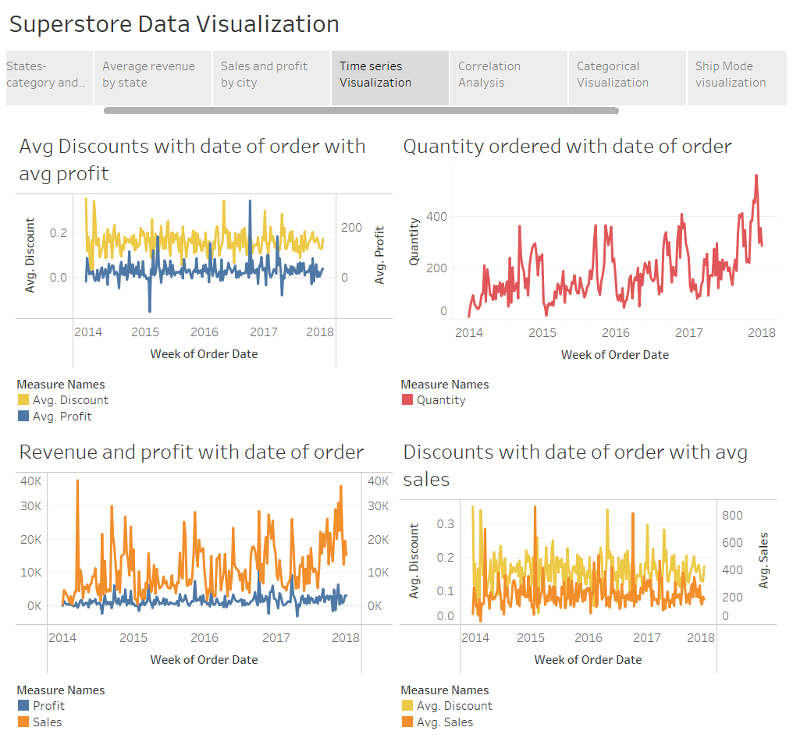

Slide 10
Insights-
1. Revenue spikes in certain months- march, September to November etc. .This may be attributed to holiday seasons or pre- summer/winter purchases, but this is not consistent every year. Hence there is a chance that revenue might spike in these months.
2. Profit may or may not reflect the above trend.
3.Quantity ordered spikes in September, falls in October and spikes in November again and shows a general increasing trend with time
4. On comparing the sales and profit trends with discount trends, it is observed that in many cases, with a spike in discount, a corresponding spike in sales and a drop in profit is noticed.

Slide 11
Actions-
In areas with high profit margin, the probable high revenue can be leveraged through holiday season/pre-(summer/winter) sales offers to encourage higher buying.
Whenever demand (quantity ordered) rises like in September and November, prices can be hiked to a certain degree and when demand falls, it can be readjusted accordingly.

Slide 12
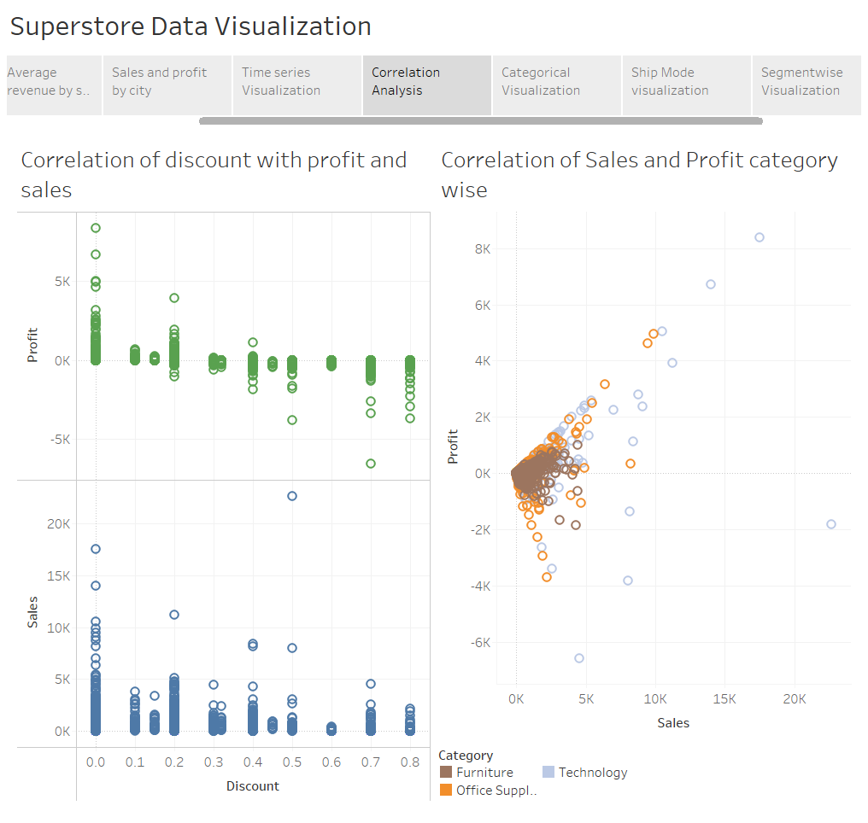

Slide 13
Insights
Profit shows a negative correlation with discount, while the correlation between sales and discount is far more ambiguous, albeit on the negative side.
Positive correlation between sales and profit.
Furniture items being sold have a lower chance of incurring a higher loss as compared to other categories, as well as a lower chance of high profits. i.e. they are low risk, low reward commodities in terms of total revenue as well as profits.
Items in other categories are more spaced out in terms of revenue as well as profits compared to furniture items.
A large proportion of all items are clustered within a small portion of the total area. Shows that large sales and large profits or losses are not as common.

Slide 14
Actions -
Since an increase in discount reduces profit and also has a marginal reducing effect on sales, it should be offered in regions where profit margin is already substantial.
Since furniture items are low risk, Regions with lower revenues but a positive profit margin(North & South Dakota, Nebraska,Kansas etc.) can focus on increasing sales of furniture items through various means to increase revenue in those areas while the risk of loss remains minimum compares to the other two categories.
Similarly, regions with substantial profit and revenue can focus on the other two categories- especially furniture as they yield higher revenue, and can mitigate any loss which may occur on selling these items.

Slide 15
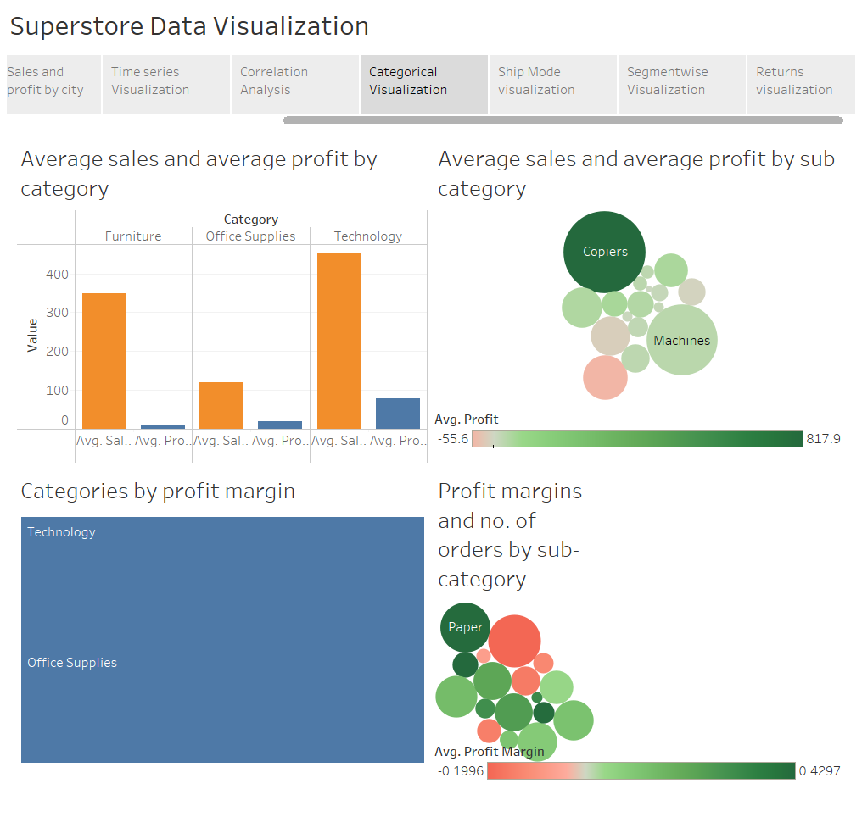

Slide 16
Insights-
Average revenue is highest in the category of Technology followed by Furniture & Office Supplies respectively while average profit is highest in the category of Technology followed by Office Supplies & Furniture respectively.
Copiers and Machines provide the most revenue out of all subcategories. Also, compared to other categories copiers provide a disproportionately large profit.
Technology and Office Supplies have a comparable profit margin while Furniture items have a much less profit margin.
Paper, Binders and Furnishings are the three most ordered subcategories
Despite high demand, binders have a negative profit margin. The rest two have positive profit margins.
Copiers, despite providing the highest profit is the least ordered item subcategory.

Slide 17
Actions-
Compared to sales of furniture, profit is lesser than what is expected. Hence there is a need of cost cutting and price revision.
Seeing that copiers provide the best profits despite it’s lower demand, the company can expand its stock of copiers to realize more gains.
Reduction in stocks and appropriate price revision of Binders and other items which have a negative average profit margin.

Slide 18
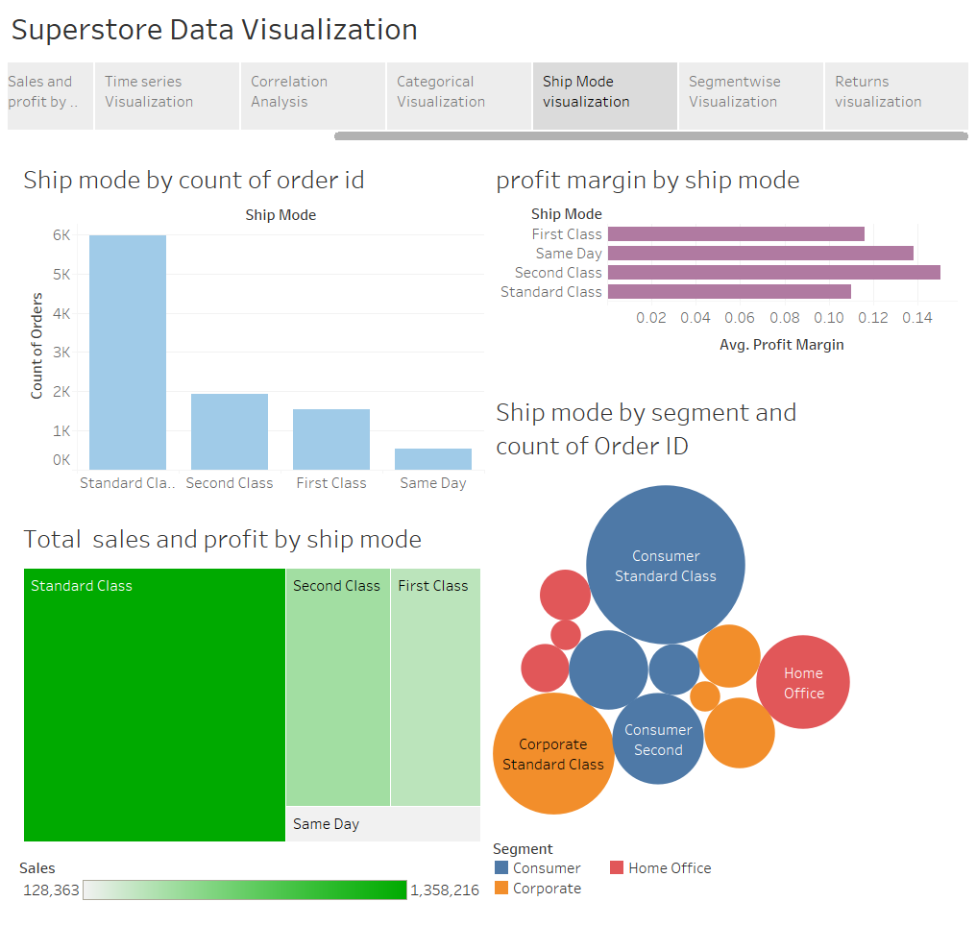

Slide 19
Insights
Most orders were shipped in standard class, followed by 2nd, 1st class and same day shipping. Standard Class has contributed the most revenue as well as profit.
Second class has the most profit margin followed by same day, first class and standard class.
Sales and profit follow the same trend as count of orders.
More orders were placed by the customer segment in standard class compared to other segments.

Slide 20
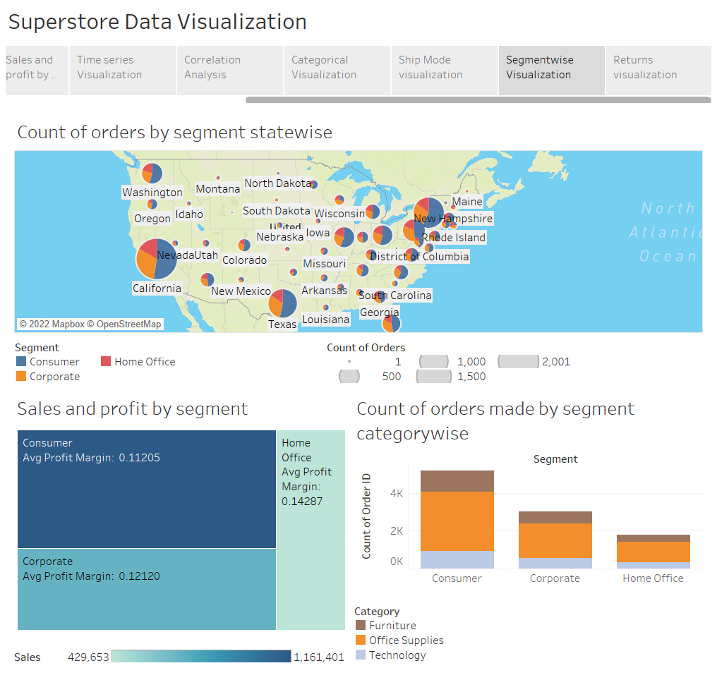

Slide 21
Insights-
Majority of orders placed by the customer segment in most of the states.
Large no. of orders placed by California, New York and Texas.
Customer segment generated most revenue as well as maximum profit. Home office segment is promising as well due to its higher profit margin.
In each segment, office supplies are the most in demand items.

Slide 22
Action-
Demand can be leveraged by increasing prices across high demand categories(office supplies in this case) and segments(Customer), especially in regions where orders are more.
Increased marketing of products in the “Home Office” genre can bring in additional revenue as well as more profit.

Slide 23
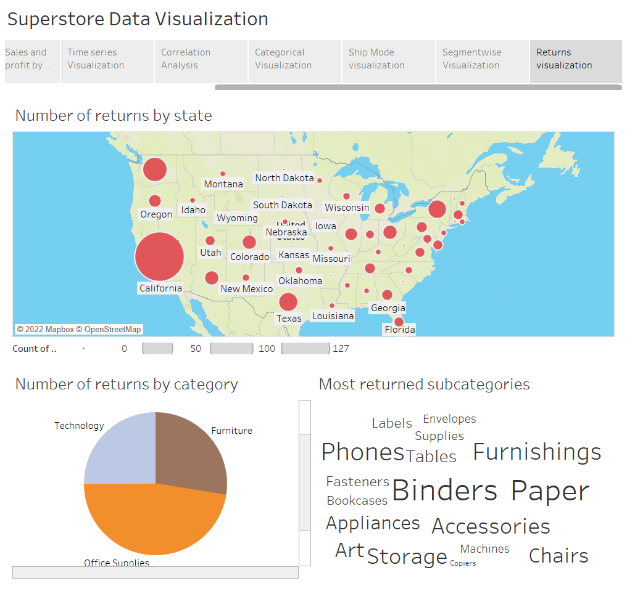

Slide 24
Insights-
California has the most returns by any state.
Office supplies are the most returned items.
Binders , Paper and Storage are the most returned subcategories.

Slide 25
Action-
Seeing the large amount of returns in California, there is a need to invest in additional quality control mechanisms in that state as well as in Washington, Texas and New York.
Increased quality control for office supplies, especially binders, paper and storage.

